Slide 1
SAPR Annual Training
Notes:
Add your name and unit and introduce yourself as a Victim Advocate, their confidential resource for sexual assault related issues. Tell the audience about your victim advocate credentials and experience to let them know that you’re a subject matter expert.
You are encouraged to engage the audience in discussion as much as possible throughout the training.

Slide 2
General Warning
We will be discussing content that could invoke strong emotions among some attendees.
Notes:
Please feel free to take a short break during the presentation or follow up with us afterwards if you’d like to talk.

Slide 3
SARCs & VAs
What We Do
Provide non-clinical support and essential information on available options and resources so clients can make informed decisions as they progress through resolution and healing such as:
Accompany clients to law enforcement interviews & court proceedings
Assist client in communicating their needs to leadership (Unrestricted Reports Only)
Assist client with expedited transfer requests process (Unrestricted Reports Only)
Assist clients in requesting MPO or CPO (Unrestricted Reports Only)
Assist client in reporting and documenting retaliation that is associated with a report of sexual assault (Unrestricted Reports Only)
Report directly to the JFHQ Lead SARC for case related matters
Not an all inclusive list
Notes:
REQUIRED: Support bullet points with examples of how this would look in real time and /or ask the audience if they can share examples of what they think its means.
Assist in communicating needs to leadership can look like client has an appointment during drill to meet with an investigator / counselor / VA, etc.; worried their supervisor (who does not know about their Unrestricted Report) will ask questions. VA can discuss with this concern with command who can address it with the supervisor without providing information related to their case.
2. Can be in the room as the client meets with investigators to provide moral support. If the interview is triggering they can ask the investigators for breaks on behalf of their client, etc.
3. Expedited Transfers: explain the process to the client and what they can request in the ET (temp reassignment, separate drill weekends from offender, etc.)
Request MPO / CPO: explain the protective order process to the client and help request them as needed. Can help develop a safety plan if one is needed.
Retaliation: explain the process of reporting retaliation and assist the client in completing the DD 2910-2 (Retaliation Reporting Form) as needed
6. All SARCs and VAs assigned to a case will report only to the FT staff on all matters regarding a case. The command cannot ask the SARC/VA for information shared by the client regarding a case. The SARC/VA cannot share information shared by the client with the command without the written permission of the client.

Slide 4
SARCs & VAs
What We Cannot Do
Investigate
Make decisions for the client even if they ask us to
Solicit clients
Not an all inclusive list
Notes:
REQUIRED: Support bullet points with examples of how this would look in real time and /or ask the audience if they can share examples of what they think its means.
Self explanatory: we can ask clients questions as needed to gather information for DSAID or to help understand their needs are but we do not investigate.
We do not tell the client what to do in any given situation. It is important they make their own choices to regain their power; only they know what they best choice is for them.
Personal / sexual relationships will damage the trust the client, leadership and others have in the SHARP/SAPR Program. It will also negatively impact the clients ability to heal from the trauma.
Solicit clients – if a SARC / VA hears from a third party that a soldier was sexually assault they will not approach that soldier first. It is important to the healing and empowerment process that the person who experienced the sexual assault reach out to, or request, the SARC/VA.

Slide 5
Overview
Definition of Sexual Assault
Consent
Prevalence & Impact of Sexual Assault
Reporting Options
Retaliation
Notes:
This is an overview of what we’ll be covering in this training.
We will start by defining sexual assault and move into how often it is happening in the United States and the New York Army National Guard to include male survivors. Then we will discuss consent and how obtaining and maintaining consent is critical to ensuring a healthy, mutual sexual relationships. Next we will discuss reporting options and gain valuable knowledge about understanding the difference between restricted and unrestricted reports. After building a framework for what Sexual Assault is and how we report it, we will talk about the extremely negative impact incidents of sexual assault have at the individual, unit and community levels. Finally, we will talk about our individual and collective responsibility to intervene and prevent sexual assault and some techniques we can utilize to do so.

Slide 6
The DoD Defines Sexual Assault as:
Intentional sexual contact characterized by the use of force, threats, intimidation or abuse of authority or when the victim does not or cannot consent.
Notes:
Can someone read the DoD definition of sexual assault?
This definition is broader than the NYS definition and includes rape, sexual assault, sexual contact, forcible sodomy or attempts to commit any of these acts.
Consent is key!

Slide 7
Contact with these body parts/regions can qualify as sexual assault
Breasts
Inner Thigh
Genitals
Buttocks
Anus
Groin
Notes:
REQUIRED:
Most people don’t remember the legal definitions but this quick picture coupled with the acronym BIG BAG can help them remember the “No-No” spots for sexual assault.
Army’s BIG BAG acronym as the “No No Square” helps people visual the sexual assault contact areas. I recommend giving a quick quiz to see if the know the difference between sexual assault contact verses sexual harassment contact. An example: if someone massages your shoulders, what could that be considered?

Slide 8
Consent
Consent is the permission we receive to initiate or continue contact. It is not implied, automatic or continuous and can never be given if a person is incapacitated, immobilized or unconscious.
Can an intoxicated person consent?
Do I need consent to initiate sex with my spouse?
If we’ve had previous sexual contact, isn’t consent a given?
If he/she invited me in, doesn’t that mean we are going to have sex?
If there is mutual attraction between a supervisor and subordinate, isn’t that consensual?

Slide 9
Prevalence & Impact of Sexual Assault
Health of the force
Individual, unit & community
Continuum of harm
Step in and stop it!
FY24

Slide 10
Prevalence in the United States
1 out of every 4 American women has been the victim of an attempted or completed rape in her lifetime
1 in 26 American men have experienced an attempted or completed rape in their lifetime.
Additionally, 1 in 3 women and about 1 in 9 men experienced sexual harassment in a public place.
https://www.cdc.gov/violenceprevention/sexualviolence/fastfact.html
Every 68 seconds another American is sexually assaulted. (National Crime Victimization Survey 2019)
Every year, 18,900 Service Members in the military experience unwanted sexual contact. (Per FY 2014 DoD Annual Survey)
https://www.rainn.org/statistics/scope-problem
FY24
Notes:
Data collected by the Center for Disease Control tells us that more than 1 in 3 women and almost 1 in 4 men will experience unwanted sexual contact in their lifetimes.
We often think about sexual assault as a gendered issue- we tend to think of females as predominantly victims. While there are gendered differences in the types of sexual violence perpetrated on men vs women, for example women are far more likely to experience rape and men are much more likely to experience sexualized hazing or bullying, the fact remains that both men and women are at considerable risk for sexual violence.
Full citation available at: https://www.cdc.gov/violenceprevention/sexualviolence/fastfact.html

Slide 11
FY 21 Annual Report of Sexual Assault in the Military
DoD received a total of 8,866 reports of sexual assault, an increase of 1,050 reports from the 7,816 reports received in FY20.
This increase in reporting was driven by increases from the Army having a 25.6 percent increase from FY20; other branches saw increases between 1.7-9.2%: there are many factors that contribute to these increases and does NOT necessarily reflect a large increase in assaults.
Survey and reporting data indicate that about 20 percent of surveyed active-duty Service members who indicated experiencing unwanted sexual contact reported their incident to a DoD authority.
https://www.sapr.mil/sites/default/files/public/docs/reports/AR/FY2021_Annual_Report_Fact_Sheet_Reference_Copy.pdf

Slide 12
https://www.cdc.gov/violenceprevention/sexualviolence/fastfact.html

Slide 13
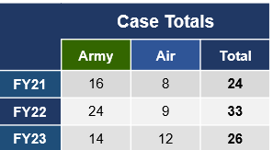
Health of the Force – NY Case Management
*Based on availability of data in DSAID as of 31 January 2024. May not match case totals.

Slide 14
The Impact of Sexual Assault
Community
Unit/NYNG
Individual
Notes:
Discussion:
-What are some of the impacts you think someone who has been sexually assaulted experiences? Have SMs list impacts at each level.
Individual
-Isolation, fear, reduction in performance, self-blame, avoidance, depression, anxiety, anger, less productive
Unit/NYNG
-Low morale, loss of unit cohesion and teamwork, disrupts good order and discipline, undermines readiness, loss of personnel
Community
-Diminishes community relations, higher rates of violent crimes, instability, degradation to community, loss of safety and trust
Key Point: When individuals are impacted by traumatic events it effects their attitude and performance, which effects others in the unit and our ability to complete the mission. Victims of rape are 6 times more likely than combat veterans to experience PTSD. Given the prevalence of sexual assault, not dealing with this issue and caring for the individuals effected can cause serious damage to our readiness.

Slide 15
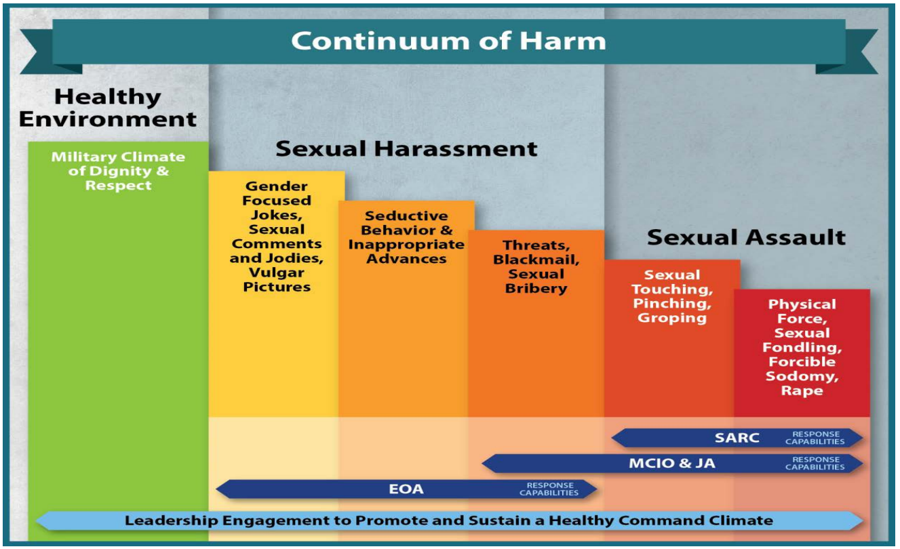
SARC
Law Enforcement & JAG
EOA
Notes:
-The Continuum of Harm shows the range of problematic sexual behavior from things we might consider minor, like jokes and innuendo, all the way to the crime of sexual assault including sodomy, rape, etc.
-We know that a small number of people commit multiple offenses. If given the opportunity, they will reoffend over and over. We also know that offenders almost always show behaviors in the sexual harassment range of the spectrum before progressing to sexual assault. If you think about it, its human nature, they will test the water to see what they can get away with before they escalate into more dangerous behavior.
Which point on the spectrum do you think is the best time to identify and stop people from progressing? (yellow)
Key Points:
-Catch the behavior before it becomes more severe and damaging.
-Sexual harassment tends to have more witnesses (=more opportunity for intervention), by the time things escalate to sexual assault, its usually just the victim and perpetrator present.
-Sexual harassment may be the only red flag we see that someone is capable of sexual assault.
-The other thing we know about sexual predators is that one of the factors that makes them reoffend-more often, more severely, or both- is when they are in environments where they perceive they are among like-minded people. The other people in the group or the unit don’t have to think the same, the perpetrator just has to believe that they do.
What kinds of behaviors in a unit might make these people think everyone else thinks the same way as them? (prompt audience to identify some of the other behaviors on the spectrum that are common in units: jokes, innuendo, sexual harassment.)
Key Points:
-We all have the power to set the standard in our unit for what is acceptable. What’s your standard?
-We can reduce sexual assault drastically by making it clear that we do not think the same as sexual predators and we will not tolerate harmful behavior.
-The FY18 DoD Annual Report found that in units where sexual harassment was occurring, females were 3 times more likely to be sexually assaulted and men were 12 times more likely to be sexually assaulted!

Slide 16
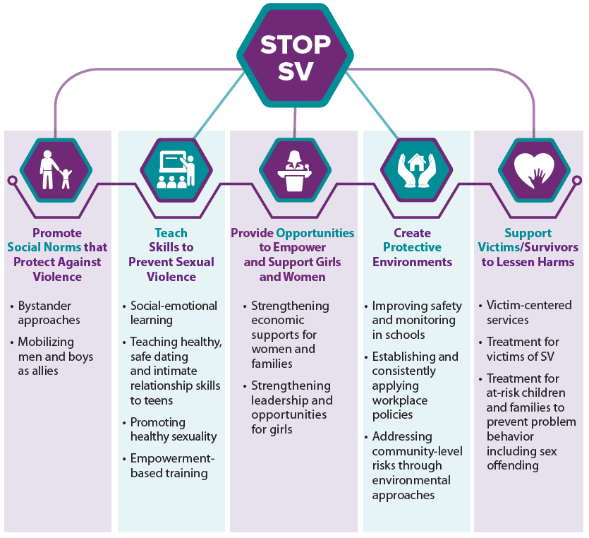
https://www.cdc.gov/violenceprevention/sexualviolence/fastfact.html

Slide 17
TAG’s Philosophy
“We have no greater priority than strength maintenance, other than soldier safety, which includes freedom from sexual assault, sexual harassment, and discrimination.”
-MG Ray F Shields Jr.
BLUF: STEP IN AND STOP IT!

Slide 18
STEP IN AND STOP IT!
Direct
Intervene in the moment and prevent the problem from happening
Distract
Interrupt the situation without directly confronting anybody
Delegate
Get help from someone who is better equipped to handle the situation
FY24
Notes:
Now that we understand our role in prevention, we’re going to talk about our role in intervening when we see red flags.
STEP IN AND STOP IT! Is the TAG’s directive when it comes to witnessing sexual harassment or sexual assault risk behaviors. It is our duty to one another.
Review the 3 D’s of bystander intervention and ask the audience whether anyone’s used these techniques?

Slide 19
Reporting Options
Restricted AND UNRESTRICTED
Expanded Eligibility for restricted reports
CATCH PROGRAM
FY24
Notes:
We have covered what sexual assault is, the impacts, and our responsibilities in terms of prevention and intervention. So what do you do if you or someone you know has experienced a sexual assault? There are 2 reporting options-Restricted and Unrestricted. We’re going to review them now.
*It’s important to remember military members have a right to make a report and receive help for incidents that happened at any time in their lives, regardless of military status at the time.

Slide 20
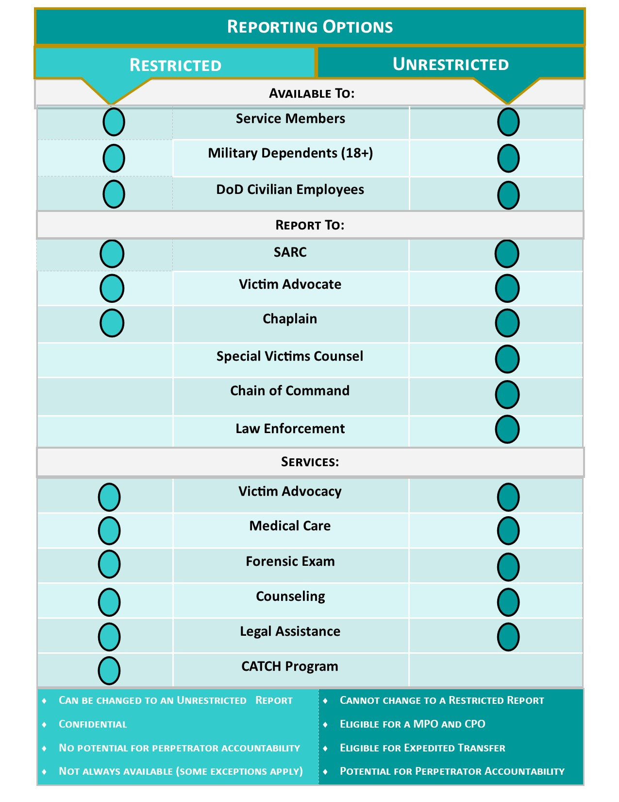
Notes:
REQUIRED:
Emphasize the following points:
Soldiers needs to remember this information for their Battle Buddy, not for themselves! When people are in trauma their brain will not allow them to recall this information and a service member who has experienced a sexual assault is more likely to tell a friend first. They will not think to call their SARC or VA; they need you, their friend, to remember for them.
If they remember nothing else just remember three people, a SARC, a VA, and a Chaplain because they can protect both reporting options. Ensure those Big 3 (SARC, VA, Chaplain) are covered and retained at the end of class.
3) On reporting options emphasize the primary difference between UR and RR is the investigation process; ask the audience which one is which. Emphasize that ONLY law enforcement agencies (Military Criminal Investigation Offices or Civilian Law Enforcement) investigate allegations of sexual assault. Commands DO NOT investigate sexual assault; it is prohibited by federal law.
4) Service members can report a sexual assault even if they were not in a duty status when the assault occurred AND they can report sexual assaults that occurred prior to military service. Both reporting options are available in either of these cases as long as they do not disclose to a mandated reporter…remember the Big 3.
Service members can report sexual assaults prior to military service and sexual assaults that occur while they are off duty in a civilian status. There is no statute of limitations on reporting to the SARC or VA; this is not the same as legal statute of limitations for offender accountability.
Adult civilian dependents (in DEERS) and T32/T5 civilian employees are also eligible for limited SAPR services.
Talking to one of the Big 3: SARC, VA, Chaplain does not require anyone to file a report and the Big 3 are not required to report anything with one exception. EXCEPTION: SARC & VA are mandatory reporters when someone discloses harm to self, harm to others, child abuse, or elder abuse. Chaplain still have 100% confidentiality.

Slide 21
Who can Accept a Report?
BOTH Restricted & Unrestricted Reports
Sexual Assault Response Coordinator (SARC)
Victim Advocate (VA)
Chaplain, medical, and behavioral health communications remain confidential, but they cannot file a report
ONLY Unrestricted Reports
Commander
JAG
IG
Notes:
Review who can accept each type of report.
If someone approaches you regarding an incident of sexual assault, you must understand the value of the information they are about to disclose. If they have not disclosed specifics to you, it’s important to escort them to the nearest VA (or SARC) or provide them the hotline information.
If someone has disclosed details to you, and you are not in the chain of command, it’s important that you not disclose the information to anyone else until the victim has made a decision as to whether they will make a restricted or unrestricted report.

Slide 22
Expedited Transfer: Unrestricted Report
Expedited Transfer – NOT available under the restricted reporting option
Applies to service member or family member who is a victim of sexual assault
Request is accomplished with a DA 4187 submitted to the chain of command
Approval is at the BDE CDR level and is considered within 72 hours of the request
This is not a permanent transfer but serves to remove the victim from a stressful situation during the course of the investigation
When possible, an expedited transfer will not affect a victim’s school date (if applicable) or other career advancement/milestones.

Slide 23
Expanded Eligibility for Restricted Reporting
As long as:
The victim did not personally report the sexual assault to military or civilian law enforcement
The victim did not previously sign a DD2910 electing to report unrestricted for the same sexual assault incident
Even if:
They disclosed the sexual assault to their commander or to personnel in their chain of command
There is an ongoing investigation into the sexual assault initiated by a third party and not due to the victim’s disclosure to law enforcement
The investigation into the sexual assault incident has been closed

Slide 24
Catch a Serial Offender Program (CATCH)
The CATCH Program gives people making a Restricted Report the opportunity to anonymously disclose suspect information to help the Department of Defense identify serial offenders.
Notes:
The CATCH program is an option for people who make a Restricted Report to anonymously share suspect information. If DOD finds that a suspect has been entered into CATCH more than once, there is a “match”, and the client will be notified by the SARC.

Slide 25
Investigation Process
Was the subject on T10 orders or did the incident happened on a military installation?
YES
NO
Unsubstantiated:
No action taken against Subject
Unsubstantiated:
No action taken against Subject
Refer to Army CID for investigation
Refer to NYSP for investigation
Substantiated:
Active component could Court Martial; most likely sent back to NYNG for administrative action
If investigation is not conclusive, refer matter to NGB OCI
If investigation is not conclusive, refer matter to NGB OCI
Substantiated:
Criminal charges; civilian process concludes and then NYNG takes administrative action
Notes:
BRIEFLY Review the investigation process.
Key points for this slide:
CID investigates those on T10 orders and if it’s occurred on a federal military installation.
NYSP investigates SAD, T32 status and if it’s occurred on a state military installation.
Examples of administrative action taken at NYNG: rank reduction, separation.
NYARNG has separated multiple Soldiers, including some O6s and E8s for sexual harassment and assault. We do not tolerate this behavior.

Slide 26
Investigation Process: NYSP Memorandum of Understanding
NYARNG is unique in that it has formed a relationship with the New York State Police for investigating incidents of sexual assault when the victim makes an UNRESTRICTED report.
Benefits of the MOU include:
A uniform approach to the investigation regardless of what geographic area of NYS the assault took place in
A direct link between investigative/law enforcement role and criminal prosecution.
If the subject of an investigation is charged with sexual assault, they will be prosecuted by New York State. Any conviction will streamline the subject's removal from NYARNG upon completion of the civilian criminal justice process
Notes:
BRIEFLY Review the investigation process.
Key points for this slide:
CID investigates those on T10 orders and if it’s occurred on a federal military installation.
NYSP investigates SAD, T32 status and if it’s occurred on a state military installation.
Examples of administrative action taken at NYNG: rank reduction, separation.
NYARNG has separated multiple Soldiers, including some O6s and E8s for sexual harassment and assault. We do not tolerate this behavior.

Slide 27
Advocacy Services Also Available For:
IAW DoDI 6495.02, Dated 10Nov21: family members (18 years of age and older) who have experienced sexual assault are eligible for advocacy and reporting services.
IAW Army Directive 2022-13, Dated 20Sep22: Service Members who have experienced sexual harassment are eligible for limited services (advocacy, mental health, medical, SVC).
IAW HQDA EXORD 110-22, Dated 16Feb22: Experiences of reprisal or retaliation related to a report of sexual harassment, sexual assault or other crime.

Slide 28
Reporting Sexual Harassment
Harassment complaints, to include witnessing or experiencing sexual harassment are reported through the EO/EEO program.
You may be entitled to a SVC, chaplain services, crisis intervention, safety assessment, resources, retaliation complaint, protective order and counseling.
If you need assistance obtaining these services, you can contact the SAPR program.
Notes:
Explain that these are limited services through the SAPR program. SAPR professionals will not intake, initiate, or process sexual harassment complaints, but will offer a referral of all sexual harassment complainants to the State Equal Employment Manager (SEEM) or Equal Opportunity (EO) personnel for reporting options and processing of the complaint. Referrals to the SEEM or EO personnel will only be made with the complainant’s permission.
At the request of the complainant, facilitate a warm hand-off to appropriate services, filing a retaliation complaint with an Inspector General or filing a retaliation complaint with the Military EO office if due to protected EO communication.
Protective order can be an MPO or CPO.

Slide 29
No Wrong Door
The No Wrong Door approach to, sexual assault, sexual harassment, and domestic abuse ensures that individuals that need assistance can get the help they need no matter where they ask for it.
Notes:
It is National Guard Bureau (NGB) policy that individuals who seek information about SAPR services from any National Guard (NG) organization or NG entity will receive full assistance as practical, and never be denied or inappropriately delayed in receiving care and support. All NG designated NWD representatives will coordinate an in-person or virtual warm handoff or transfer of the individual requesting assistance to another service provider to ensure the individual receives the most appropriate care and services.

Slide 30
Retaliation
Reprisal,ostracism,cruelity/maltreatment
FY24

Slide 31
Retaliation

Slide 32
Retaliation Behaviors
Reprisal (CoC Action)
Withholding of favorable actions; or imposing negative personnel actions
For making, preparing to make, or being perceived as making or preparing to make a protected communication.
Can be reported to the SARC, Command, or State/DoD IG
This type of retaliation should be investigated by the Inspector General.
Ostracism (Peers)
Excluding from social acceptance, privilege, or friendship
For making, preparing to make, or being perceived as making or preparing to make a protected communication.
Can be reported to the SARC, Command, or State/DoD IG
This type of retaliation should be investigated by the victim’s chain of command.
Cruelty/ Maltreatment
Cruel / oppressive acts (Physical or Psychological)
By superior (Article 93)
or peers (AR 600-20)
Inherently criminal activity (ie, assault, property damage, stalking)
For making, preparing to make, or being perceived as making or preparing to make a protected communication.
Can be reported to the SARC or Command

Slide 33
Retaliation Reporting
There is a formal reporting process for retaliation, which includes completing the DD 2910-2 and will include an investigation of the report
You can report retaliation to the Commander, IG, and/or SARC (depending on type of retaliation your comfort level in reporting to your Chain of Command may vary – it’s important to know you have these other resources available to you/your battle buddy)

Slide 34
Points of Contact
JFHQ SARC (Full-time): Mrs. Jackie O’Keefe, 518-786-4734
JFHQ VA (Full-time): Ms. Yvonne Masse, 518-786-4956
JFHQ M-Day SARC: MAJ Robin MacHattie, robin.j.machattie.mil@army.mil
24/7 NY SHARP Line:
518-339-7586
DoD Safe Helpline:
877-995-5247
FY24
Notes:
Please fill in contact information for VAs in your unit.

