Slide 1
NEW YORK NATIONAL GUARD FAMILY PROGRAMS
Linda Rennie
Military and Family Readiness Specialist
518-786-0390

Slide 2
Director Federal HRO
(GS-14)
COL Michelle Buonome
Deputy State Chaplain
(GS-12)
MAJ Timothy Miller
State Family
Programs Director
MSG Michael Blass
Transition Assistance Specialist
(GS-11)
Rochester
Larry Linville
Military One Source
VACANT
Family Programs
Plans Officer ADOS
1LT Daniel Hill
Lead Military & Family Readiness Specialist
(GS-11)
Latham
Linda Rennie
Lead Military & Family Readiness Specialist
(GS-11)
NYC
Betty Eissfeld
R3SP Program Manager
CW4 Larry Langley
Transition Assistance Advisor (TAA)
Latham
Dave Earsing
NYC
VACANT
Child & Youth
Steffi Fauré
Kimberly Groshans
Family Programs ADOS
SSG Austin Osborn
SGT Ryan Schyberg
SGT Thomas King
SPC Ayla Goronkin
PFC Alex Lopez
Military & Family Readiness Specialist
(GS-9)
Buffalo
Maggie Murray
Michael Stanton
Latham
Taylor Cross
Rochester
Joel Beardsley
Gary Pike
Syracuse
Tyler Swartz
Troy
Steve Marchese
Military & Family Readiness Specialist
(GS-9)
Camp Smith
VACANT
Farmingdale
Laraine Figliuolo
Ft. Hamilton
Melissa Wong
Harlem
VACANT
Ronkonkoma
Brian Randolph
New Windsor
Shelly Aiken
Risk Reduction Coordinator/
Alcohol & Drug Control Officer
Latham
Patricia Lopez
ESGR
Daisy Smith
Personal Financial Counselors
Buffalo
Timothy Sobolewski
Latham
Lisa Dapolito
Brooklyn
Calvin Lipscomb
Farmingdale
Paula Mucci
Rochester
Ken Moyer
Scotia/Stratton
Roger Greenwood
Substance Abuse
Prevention
Coordinators
Buffalo
Julia Blujus
Latham
Isabella Denysenko
Syracuse
Jessica Mulet (P/T)
Suicide Prevention
Coordinator
Latham
Aidan O’Neil
DEERS/HR Assistant
(GS-7)
Latham
Lis Lowe
9/16/22
TITLE 32
TITLE 5
AGR
ADOS
Contractor

Slide 3
New York National Guard
Family Programs
Military and Family Readiness Specialists (MFRS)
Provide Service Members, Families and Veterans with information, referral and outreach. Regardless of their service component.
Provide Commanders, Service Members, Family Members and volunteers with Family Programs support, hands-on assistance in establishing and maintaining an effective Soldier Family Readiness Group (SFRG).
Child & Youth Program
Address the needs of our military youth, offering safe activities, a place to meet, talk, and have fun with youth who understand each others issues.
Employer Support of the Guard and Reserve (ESGR)
As a National Guard member, the time spent away from the workplace on drills and deployments could cause employment challenges. NGB partners with Employer Support of the Guard and Reserve (ESGR) to improve the quality of life of Service Members and their Families by promoting the security of their civilian jobs. We provide education, employment opportunities, ombudsman services, and Employer Awards for employers who support a Service Member employee.

Slide 4
Military OneSource
Military OneSource is a Department of Defense-funded program providing information on every aspect of military life at no cost to all Active Duty, Guard and Reserve Component Service Members, and their Families. Military OneSource is available 24 hours a day by telephone and online.
Personal Financial Counselor
Personal Financial Counselors provide free confidential financial consultations for Soldiers and their families. They also provide referrals to community resources. They are ready to support service and family members during all stages of the deployment cycle. They help with credit management, budgeting and understanding Credit Reports, assist with navigating benefits and more.
.

Slide 5
Resilience, Risk Reduction and Suicide Prevention (R3SP)
The NYARNG R3SP Program will promote resilience among Soldiers and Family Members. Enhance skills to recognize at risk factors, mitigate high stress and facilitate long term reduction of high risk behaviors, drug and alcohol addiction, and suicide actions through training, educations and resources
Transition Assistance Advisor
Transition Assistance makes accessing the benefits and entitlement earned by Service Members easier. Here you’ll find valuable information about programs and services addressing a variety of issues, from financial matters, to funeral honors, to emotional support.
Yellow Ribbon Team
Plans, coordinates and hosts Yellow Ribbon Pre – During – and Post Deployment Events for Service Members and their Families to assist them with reintegration.

Slide 6
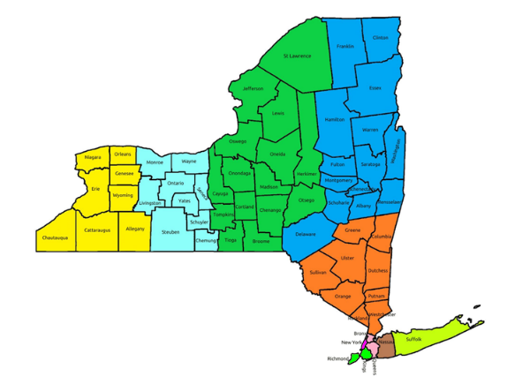
Where We Are Located
Service Member & Family Resource Centers (SMFRC) are located in ten convenient locations in New York State and are staffed with Military & Family Readiness Specialists (MFRS).
MFRS’s are easy to reach, ready to help, and serve as a one-stop shop for information and referrals.

Slide 9
Military and Family Readiness Specialist
Eight Essential Services
Legal Resources and Referral
Financial Resources and Referrals
TRICARE Resources and Referrals
ID Cards and DEERS
Crisis Intervention and Referral
Community Information and Outreach
Exceptional Family Member Program EMFP
Emergency Family Assistance Center EFAC
Outreach to Families
Every 30 days during mobilization and deployment
Community Capacity Building /(JCF) Joining Community Forces
Optimize Network Providers through Cross-Referrals:

Slide 10
Legal Resources and Referrals
Assist person with Legal matters
Sample areas of law:
Selected Resources:
Wills, Power of Attorney,
Service Members Civil Relief Act
Divorce and Family Law;
Immigration Issues;
Bankruptcy; Credit and Collections;
Real Estate; Landlord/Tenant; Foreclosure;
Labor and Employment; Workers’ Compensation & Disability/SSD
Personal Injury;
Legal Aid Society of Northeastern NY
USERRA
ESGR
New American Hotline

Slide 11
Financial Resources and Referrals
Sample areas of Financial Concerns :
Selected Resources:
Military Pay
Financial Assistance (Grants and Loans)
Financial Education
Insurance
Retirement
Investment
Education
Budgeting
Debt Management
National Guard & Naval Militia Relief Society
The New York National Guard Family Readiness Council, Inc. (NYNGFRC, Inc.)
Personal Financial Counselor: Lisa Dapolito (Latham)
GI Bill ( MSG Landry, Education Services )
Military One Source

Slide 12
Tricare Resources and Referrals
Tricare (styled TRICARE), is a health care program of the United States Department of Defense Military Health System.
TRICARE MUST KNOW:
Selected Resources:
One must be registered in DEERS
Health Plan Options
Pharmacy program
Dental plans
Special programs for specific health care needs
Out-of-Pocket Costs
Health Plan Costs
Prescription Costs
Dental Costs
www.Tricare.mil
www.humanamilitary.com
TRICARE East 1-800-444-5445
TRICARE (Humana) 1- 877-256-1640

Slide 13
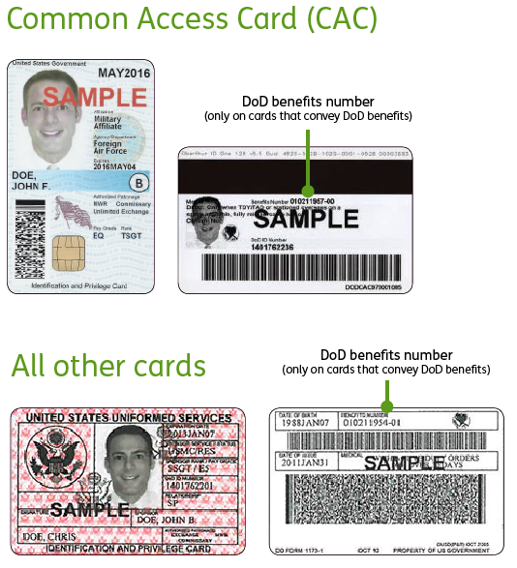
ID Cards and DEERS
Provide assistance with obtaining Dependent ID Cards. Appointment and requirements information
ID CARD & DEERS:
Selected Resources:
Real-Time Automated Personnel Identification System (RAPIDS)/ID Card Office system used to issue the definitive credential within DoD
Defense Enrollment Eligibility Reporting System(DEERS) is a database of information on uniformed services members (sponsors), U.S. sponsored foreign military, DoD and uniformed services civilians and their family members.
RAPIDS uses information stored in the DoD DEERS when providing credentials (IDs and CAC)
Latham
330 Old Niskayuna Road, Room 206
Latham, NY 12110
(518) 786-4406
Appointment Scheduler https://rapids-appointments.dmdc.osd.mil/appointment/default.aspx

Slide 14
Crisis Intervention and Referral
Crisis Intervention refers to precautions taken in the event of intense difficulty or danger. Some actions required may seem drastic but may be the best solution for the safety of all.
Selected Resources:
Selected Resources:
Red Cross https://www.redcross.org/get-help.html American Red Cross of Northeastern New York 33 Everett Road, Albany, NY 12205 Phone: (518) 458-8111 To speak to a Red Cross Emergency Communications Specialist call: 1-877-272-7337
The Police Department: 911
Military Crisis Line (1-800-273-8255)
Behavior Health (Family Programs)
New York State Domestic Violence Hotline 1-800-942-6906

Slide 15
Community Information and Outreach
Community resources refers to any aspect of the community that may assist one with the needs of daily life.
OUTREACH AREAS:
Selected Resources:
Child care and Elder care
Employment assistance
Substance abuse
Housing
Shelters
Clothing
Educational assistance
Car repairs
Phone and Internet
Immigration Assistance
Mental health care
Albany County Assistance Program www.needhelppayingbills.com
Child Care Subsidy Program www.albanycounty.com (518) 447-7435
Albany County Department of Social Services 518-447-7300
Albany Stratton VA Medical Center (518) 626-5000

Slide 16
Exceptional Family Member Program
Exceptional Family Member Program (EFMP) is designed to assist military families with a special needs family member. Support provided includes community support, housing, medical, educational, and personnel services to military Families with an Exceptional Family Member EFM.
Selected Resources:
Keller Army Community Hospital (Enroll) 900 Washington Road
West Point, NY 10996
(845-938-6881)
New York State Office for People with Developmental Disabilities (866) 946-9733

Slide 17
Emergency Family Assistance Center (EFAC)
The Emergency Family Assistance Center (EFAC) is the central point for coordinating a response to a natural or man made disaster. The EFAC is a site where soldiers and their families can receive accurate information in a sensitive, timely, and effective manner. The EFAC will assist or support with short-term recovery, long-term recovery, and the return to a stable environment and mission ready status following all-hazard incidents.

Slide 18
NEW YORK NATIONAL GUARD FAMILY PROGRAMS
Please visit Family Programs at the
Division of Military and Naval Affairs at:
www.dmna.state.ny.us/family
or call us Toll Free at
1-877-715-7817
For more information, please contact us at:
ng.ny.nyarng.mbx.family-programs@army.mil
Notes:
Thank you for participating today. I hope this presentation helped to provide you with some insight into NYNG Family Programs. I welcome any questions you may have at this time.

Slide 19
What are your Questions?

